Slide 1

DEPARTMENT OF CSE (ARTIFICIAL INTELLIGENCE AND MACHINE LEARNING) ACADEMIC YEAR 2025 - 2026 SEMESTER III ARTIFICIAL INTELLIGENCE LABORATORY MINI PROJECT REVIEW ROBOT NAVIGATION SYSTEM
REGISTER NUMBER | 2117240030022
NAME | DEEPIKA S
YEAR | 2
SECTION | A
FACULTY IN-CHARGE | Mrs. M. Divya

Slide 2
PROBLEM STATEMENT
Overview:
This project focuses on developing a Robot Navigation System that can move from a start point to a destination by finding the shortest and safest path using the A* (A-star) heuristic algorithm.
Problem Definition:
This project solves that problem by using the A* algorithm, which uses heuristic estimation to find the optimal path quickly and accurately.
Objectives:
To enable the robot to detect and avoid obstacles in its path.
To find the shortest and most efficient route from source to destination.
Expected Output:
The system should display the shortest path between the start and goal points while avoiding obstacles.

Slide 3
THEORETICAL BACKGROUND
Theoretical background about the problem:
The robot navigation system uses Artificial Intelligence to help robots move from a start point to a destination efficiently while avoiding obstacles.
The A* (A-star) heuristic pathfinding algorithm is applied to find the shortest and most optimal path using intelligent estimation.
Literature survey of the given problem:
pathfinding algorithms like Dijkstra’s Algorithm and Breadth-First Search (BFS) can find paths but are slow for large grids.
Heuristic algorithms such as Greedy Best-First Search and A* improve efficiency
Justification for choosing the algorithm:
The A* algorithm is chosen because it combines the strengths of Dijkstra’s (accuracy) and Greedy Search (speed).
It guarantees the shortest path with less computation time and is ideal for grid-based robot movement.

Slide 4
IMPLEMENTATION AND CODE
Link to code in Git-hub Repository
List | Git-hub Repository Links
Implementation of Code Link
Word Document Report Link
PPT Link

Slide 5
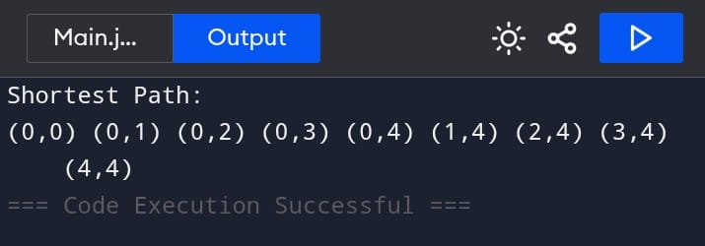
OUTPUT AND RESULTS

Slide 6
OUTPUT AND RESULTS
Explanation:
The project uses the A* (A-star) heuristic pathfinding algorithm to help a robot navigate from a starting point to a goal while avoiding obstacles.
The algorithm calculates the best path using the formula f(n) = g(n) + h(n)
Result:
The system successfully finds the shortest and most efficient path between the start and goal points.
The output displays the sequence of coordinates representing the robot’s movement across the grid.
Enhancement:
Added path visualization
improved efficiency with priority queue
included clearer variable names for better readability and debugging

Slide 7
REFERENCES
References:
1. Russell, S. J., & Norvig, P. (2021). Artificial Intelligence: A Modern Approach (4th Edition). Pearson Education.
2. GeeksforGeeks. A Search Algorithm – Implementation and Applications.*Available at: https://www.geeksforgeeks.org/a-search-algorithm/
3. TutorialsPoint. Artificial Intelligence – Heuristic Search.Available at: https://www.tutorialspoint.com/artificial_intelligence
/4. Atsushi Sakai et al. (2023). PythonRobotics: Open Source Robotics Algorithms.GitHub Repository: https://github.com/AtsushiSakai/PythonRobotics
5. ResearchGate. A Path Planning for Autonomous Robots.*

